Slide 1
Electric Charge
Definition: The quantity of electricity that flows in a given time or is held in a component such as a capacitor
Symbol: q
Unit: Coulomb (C)
Notes: Charges may be positive or negative
Like charges (e.g., + and +) repel each
other, unlike charges (+ and -) attract each
other
EE 42 and 100, Fall 2005
Week 1

Slide 2
Electric Current
Definition: rate of positive charge flow
Symbol: i
Units: Coulombs per second ≡ Amperes (A)
i = dq/dt
where q = charge (in Coulombs), t = time (in seconds)
Note: Current has polarity (flow direction).
EE 42 and 100, Fall 2005
Week 1

Slide 3
Electric Potential (Voltage)
Definition: energy per unit charge expended in moving a
charge from one place to another
Symbol: v
Units: Joules/Coulomb ≡ Volts (V)
v = dw/dq
where w = energy (in Joules), q = charge (in Coulombs)
Note: Potential is always referenced to some point.
a
Subscript convention:
v_{ab} means the potential at a minus the potential at b.
b
v_{ab} ≡ v_{a} - v_{b}
EE 42 and 100, Fall 2005
Week 1

Slide 4
Electric Power
Definition: amount of energy transferred per unit
time
Symbol: p
Units: Joules per second ≡ Watts (W)
p = dw/dt = (dw/dq)(dq/dt) = vi
Concept:
  As a positive charge q moves through a drop in voltage of amount v, it loses energy
  energy change = qv
  rate is proportional to # charges/sec
EE 42 and 100, Fall 2005
Week 1

Slide 5
The Ideal Basic Circuit Element
i
Polarity reference for voltage can be
indicated by plus and minus signs
Reference direction for the current
is indicated by an arrow
Examples: resistor, capacitor,
inductor, diode, …
+
v
_
Attributes:
Two terminals (points of connection)
Cannot be subdivided into other elements
Mathematically described by its current-voltage
relationship
EE 42 and 100, Fall 2005
Week 1

Slide 6
A Note about Reference Directions
A problem like “Find the current” or “Find the voltage” is always accompanied by a definition of the direction:
i
- v +
In this case, if the current turns out to be 1 mA flowing to the left, we would say i = -1 mA. (See prefixes in Hambley, p. 18.)
In order to perform circuit analysis to determine the voltages and currents in an electric circuit, you need to specify reference directions. There is no need to guess the reference direction so that the answers come out positive, however.
EE 42 and 100, Fall 2005
Week 1

Slide 7
Sign Convention for Power
Passive sign convention
p = vi
p = -vi
i
i
i
i
_
v
+
_
v
+
+
v
_
+
v
_
If p > 0, power is being delivered to the gray box.
If p < 0, power is being extracted from the box.
EE 42 and 100, Fall 2005
Week 1

Slide 8
Circuit Elements
5 ideal basic circuit elements:
  voltage source
  current source
  resistor
  inductor
  capacitor
Many practical systems can be modeled with just sources and resistors
The basic analytical techniques for solving circuits with inductors and capacitors are the same as those for resistive circuits
active elements, capable of
generating electric energy
passive elements, incapable of
generating electric energy
EE 42 and 100, Fall 2005
Week 1

Slide 9
Electrical Sources
An electrical source is a device that is capable of converting non-electric energy to electric energy and vice versa.
  Examples:
  battery: chemical electric
  dynamo (generator/motor): mechanical electric
Electrical sources can either deliver or absorb power
EE 42 and 100, Fall 2005
Week 1

Slide 10
Ideal Independent and Dependent Voltage Sources
Circuit element that maintains a prescribed voltage across its terminals, regardless of the current flowing in those terminals.
  Voltage is known, but current is determined by the circuit to which the source is connected.
The voltage can be either independent of dependent on a voltage or current elsewhere in the circuit, and can be constant or time-varying.
Circuit symbols:
v_{s}
+
v_{s}=μ v_{x}
+
v_{s}=ρ i_{x}
+
_
_
_
independent
voltage-controlled
current-controlled
EE 42 and 100, Fall 2005
Week 1

Slide 11
Ideal Independent and Dependent Current Sources
Circuit element that maintains a prescribed current through its terminals, regardless of the voltage across those terminals.
  Current is known, but voltage is determined by the circuit to which the source is connected.
The current can be either independent or dependent on a voltage or current elsewhere in the circuit, and can be constant or time-varying.
Circuit symbols:
i_{s}
i_{s}=α v_{x}
i_{s}=β i_{x}
independent
voltage-controlled
current-controlled
EE 42 and 100, Fall 2005
Week 1

Slide 12
Electrical Resistance
Resistance: Electric field is proportional to current density, within a resistive material. Thus, voltage is proportional to current. The circuit element used to model this behavior is the resistor.
  Circuit symbol:
  Unit for R: Volts per Ampere ≡ ohms (Ω)
The current flowing in the resistor is proportional to the voltage across the resistor:
v = i R
where v = voltage (V), i = current (A), and R = resistance (Ω)
R
(Ohm’s Law)
EE 42 and 100, Fall 2005
Week 1

Slide 13
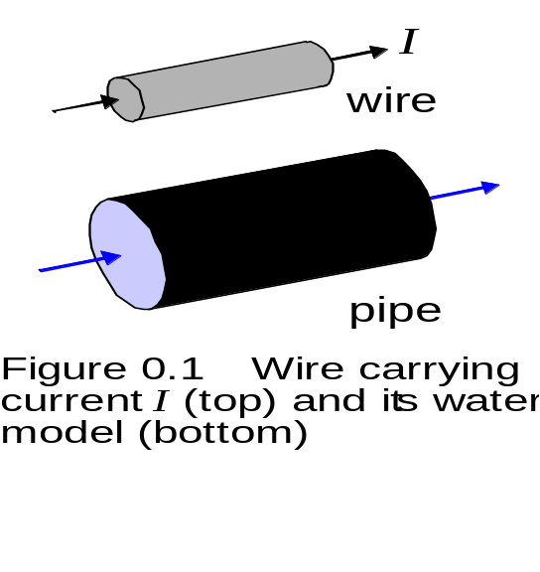
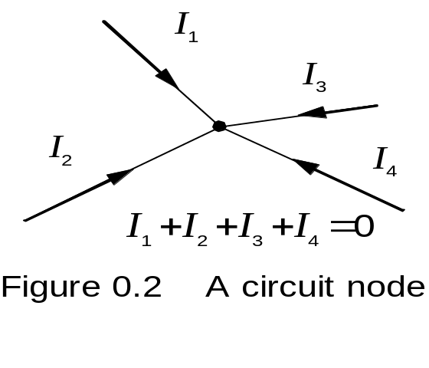
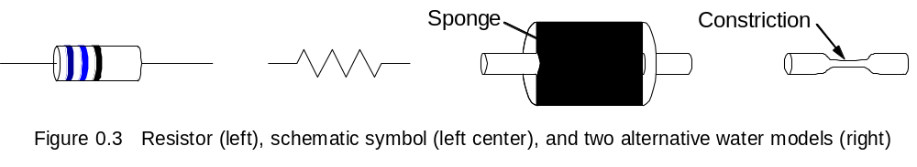
Water Models for Currents and Resistors
EE 42 and 100, Fall 2005
Week 1

Slide 14
Electrical Conductance
Conductance is the reciprocal of resistance.
  Symbol: G
  Units: siemens (S) or mhos ( )
  Example:
    Consider an 8 Ω resistor. What is its conductance?
Ω
EE 42 and 100, Fall 2005
Week 1

Slide 15
Short Circuit and Open Circuit
Wire (“short circuit”):
R = 0 → no voltage difference exists
  (all points on the wire are at the same potential)
Current can flow, as determined by the circuit
Air (“open circuit”):
R = ∞ → no current flows
Voltage difference can exist, as determined by the circuit
EE 42 and 100, Fall 2005
Week 1

Slide 16
Circuit Nodes and Loops
A node is a point where two or more circuit elements are connected.
A loop is formed by tracing a closed path in a circuit through selected basic circuit elements without passing through any intermediate node more than once
EE 42 and 100, Fall 2005
Week 1

